Slide 1
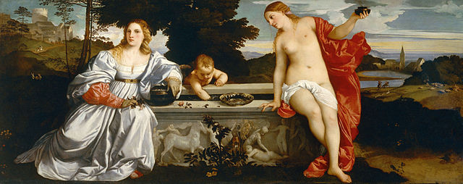
History 336: Ideas and Society in Early Modern Europe: The Debate about Gender and Identity

Slide 2
Learning and Literacy
You will find references to some primary sources by early modern women on pp. 152-65. The women mentioned on these pages are worth knowing, especially Margaret Roper, Marguerite de Navarre, Louise Labé, Anna Maria von Schurman, Madame de Pompadour. Look at these two other portraits of Madame de Pompadour: 1, 2. Why are they significant in the context of Chapter 4?
You should also know what a salonnière is.

Slide 3
Basic Question
How is gender a useful category of historical analysis when considering female literacy and learning?

Slide 4
Women and Gender, chapter 4
1. In what settings did women learn how to read? What did they typically read?
2. To what extent did Renaissance humanism favour education for women? What can we learn from a consideration of female humanists?
3. What arguments in favour of education for women emerged in the seventeenth and eighteenth centuries?
4. What opportunities did courts and salons afford women?
5. What types of women exercised cultural patronage? What was significant about women's roles as patrons?
6. Did the early modern period represent progress for the cause of the education of women?

